Slide 1
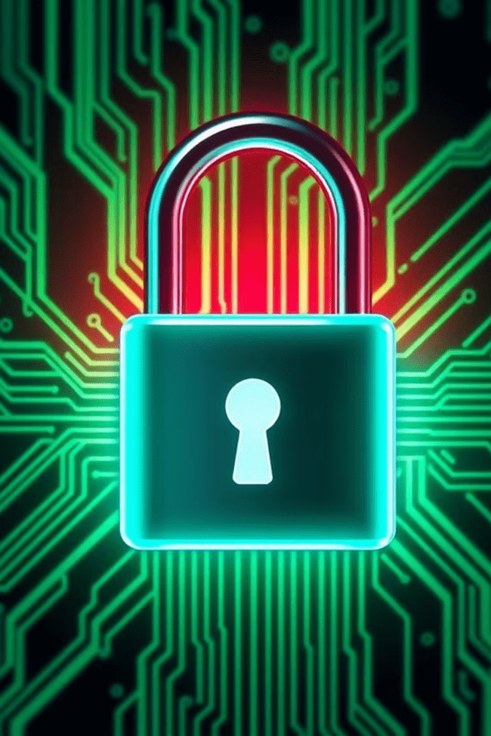
Cybersecurity Awareness
Protecting GreenTree’s Digital Workplace
Presented by: Ansh Upadhyay
Date: 30/06/2025

Slide 2
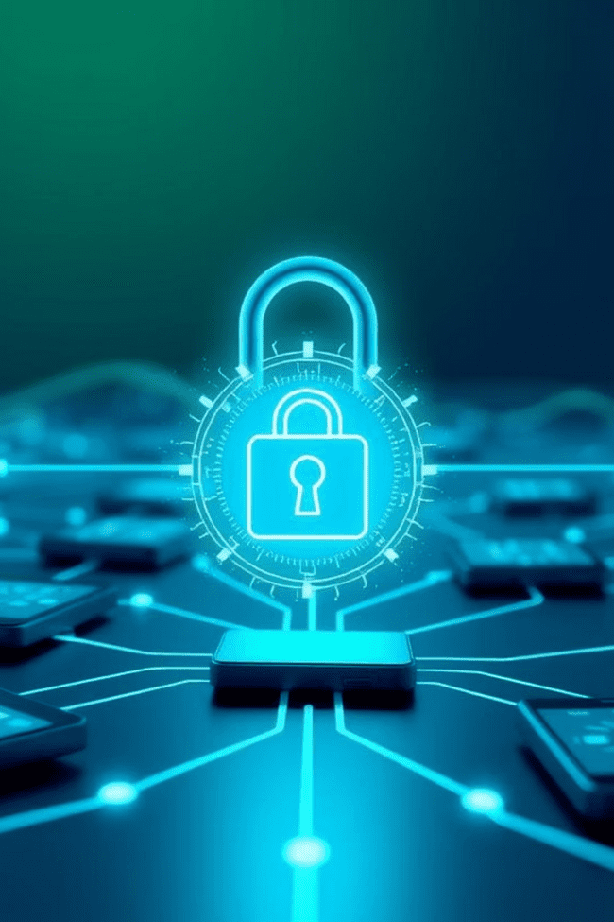



Why Cybersecurity Matters
Threats to All Businesses
One Click, Major Risk
Cyber threats are indiscriminate; they target businesses of all sizes, from small startups to large corporations. No one is immune.
A single, seemingly innocent click can unintentionally expose sensitive company data, jeopardizing GreenTree's operations and reputation.
Everyone's Responsibility
Cybersecurity isn't just for IT. Every GreenTree employee plays a vital role in maintaining a secure digital environment.

Slide 3
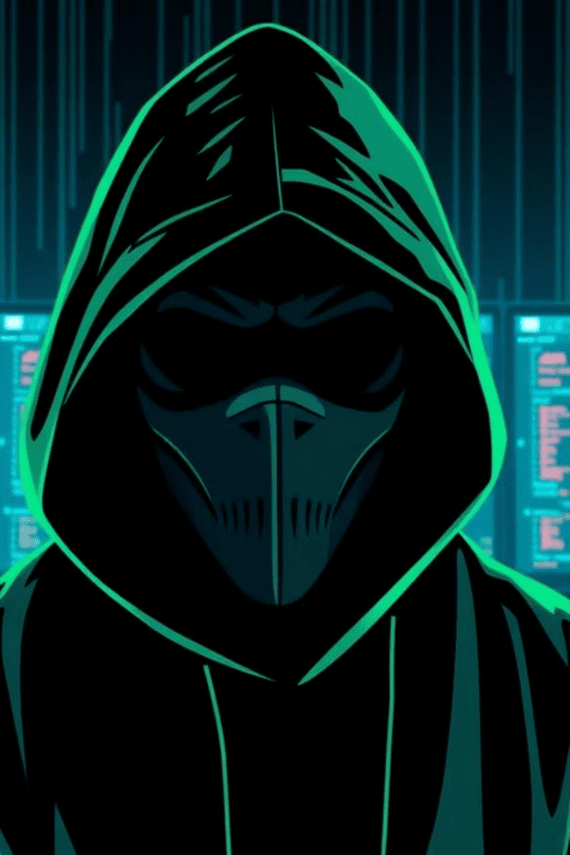
Common Cybersecurity Threats
Phishing
Deceptive emails or messages designed to trick you into revealing sensitive information like passwords or financial details. They often mimic trusted sources.
Malware
Malicious software, including viruses, worms, and Trojans, designed to damage, disable, or gain unauthorized access to computer systems.
Ransomware
A type of malware that encrypts your files and demands a ransom payment (usually in cryptocurrency) to restore access.
Social Engineering
Manipulative tactics that exploit human psychology to trick individuals into divulging confidential information or performing actions that compromise security.

Slide 4
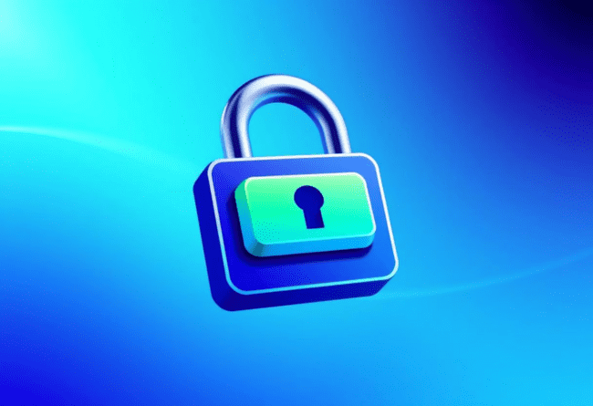
Password Best Practices
Use Strong, Unique Passwords: Combine uppercase and lowercase letters, numbers, and symbols. Avoid easily guessed information like birthdays.
Enable Multi-Factor Authentication (MFA): Adds an extra layer of security by requiring two or more verification factors to gain access.
Never Share Passwords: Keep your passwords confidential. No GreenTree staff will ever ask for your password via email or phone.
Use a Password Manager: Consider using a secure password manager to generate and store complex passwords safely.

Slide 5





Email & Link Safety
Don't Click Unknown Links
Check Sender Addresses
Hover over links to preview the URL before clicking. If it looks suspicious, don't click.
Verify the sender's email address. Look for subtle misspellings or unusual domains.
Report Suspicious Emails
Don't Reply or Forward
Use Outlook’s built-in phishing button to report any suspicious emails directly to the IT team.
Never reply to or forward suspicious content. Deleting it is often the safest option.

Slide 6
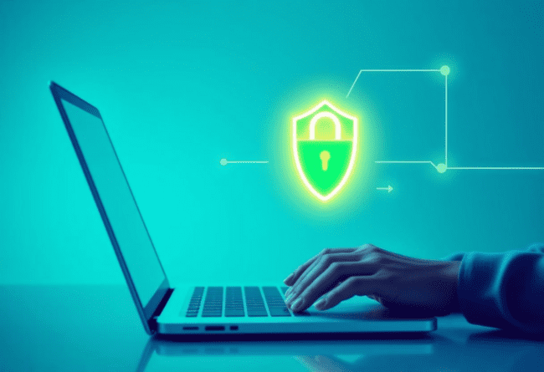
Device & Internet Security
Use VPN When Remote: Always connect to GreenTree's Virtual Private Network (VPN) when working from outside the office.
Lock Your Screen: Whenever you step away from your workstation, even for a moment, lock your computer screen.
Avoid Public Wi-Fi Without Protection: Public Wi-Fi networks are often unsecure. Do not access sensitive GreenTree data without a VPN.
Avoid Unapproved Apps: Only install software approved by GreenTree IT to prevent malware and vulnerabilities.

Slide 7

What To Do If You See Something Suspicious
Take a Screenshot
Don't Panic
If possible and safe, capture a screenshot of the suspicious activity or email for documentation.
Stay calm. Rash decisions can sometimes make the situation worse. Take a deep breath.
Disconnect If Necessary
Report Immediately to IT
If you suspect an active breach, disconnect your device from the internet as a last resort to contain the threat.
Contact the GreenTree IT team using known, verified contact methods. Do not reply to the suspicious source.

Slide 8
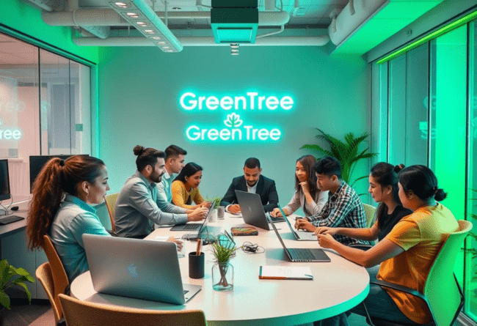
Your Role at GreenTree
Stay Alert and Informed: Cybersecurity threats evolve. Stay updated on new risks and best practices.
Follow Policy Documents: Adhere to all GreenTree cybersecurity policies and guidelines. They are designed for your protection.
Help Teammates Stay Safe: Share your knowledge and encourage colleagues to practice good cybersecurity habits.
Ask Questions When in Doubt: If something feels off, or you're unsure, always ask the IT team. It’s better to be safe than sorry.
Take the "Cybersecurity Awareness Quiz v1.0"
Submit screenshot to your team lead. Read the Cybersecurity Policy on SharePoint.
Questions? Email security@greentree.in

